Slide 1
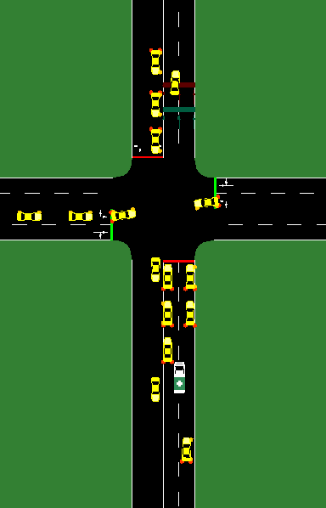
Introduction
EMS vehicles getting from point A to point B should be top priority on the road
Use adaptable traffic lights to give EMS vehicles extra time to react
EMS Vehicle Behavior
Bluelight devices
Civilians reacting to the EMS vehicle
Lane splitting
Going through red lights and over the speed limit
Simulations
What the simulations look like (throw some pictures up)
Different netoworks
CityFlow
We initially planned on using CityFlow because it was a fast traffic simulator, however over time we realized it did not have the functionality we needed.
Conclusions
Our policies significantly improved EMS travel time while keeping the congestion clearing time relatively unharmed.
Simulation of Urban MObility
SUMO became our main simulation tool to create networks and collect data. It has lots of documentation that helped us learn the software
Netedit to create networks that we wanted to simulate
Sumo-gui to watch the simulations
Traci to enhance the simulations and collect data for analysis
Data Collection
Used Traci to create 3 different scenarios
Green corridor – Traffic lights detect the approaching EMS vehicle and turns the upcoming traffic lights green for it to allow cars to move out of the way
Red Freeze – Shuts down the intersection so no cars go through allowing the EMS vehicle to bypass them while they are stopped
Control – No traffic light behavior was manipulated
Some results were omitted due to out of the ordinary results. This is a result of how SUMO simulations work. Sometimes you get unlucky, and vehicles get stuck in weird configurations. I eliminated all the outliers.
Lessons Learned
Had to pivot from CityFlow to SUMO
A lot of software to learn and work to develop
We also had to combine multiple together (XML, config files, Python, etc.)

